Slide 1




Astronomy 1020 chapter 20
Clayton State University
Slides for Astronomy textbook from OpenStax
https://openstax.org/books/astronomy/

Slide 2
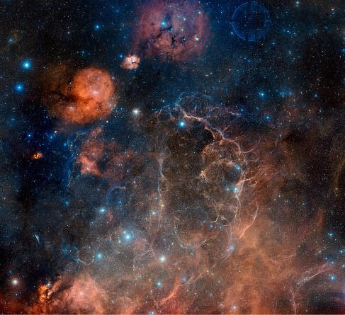
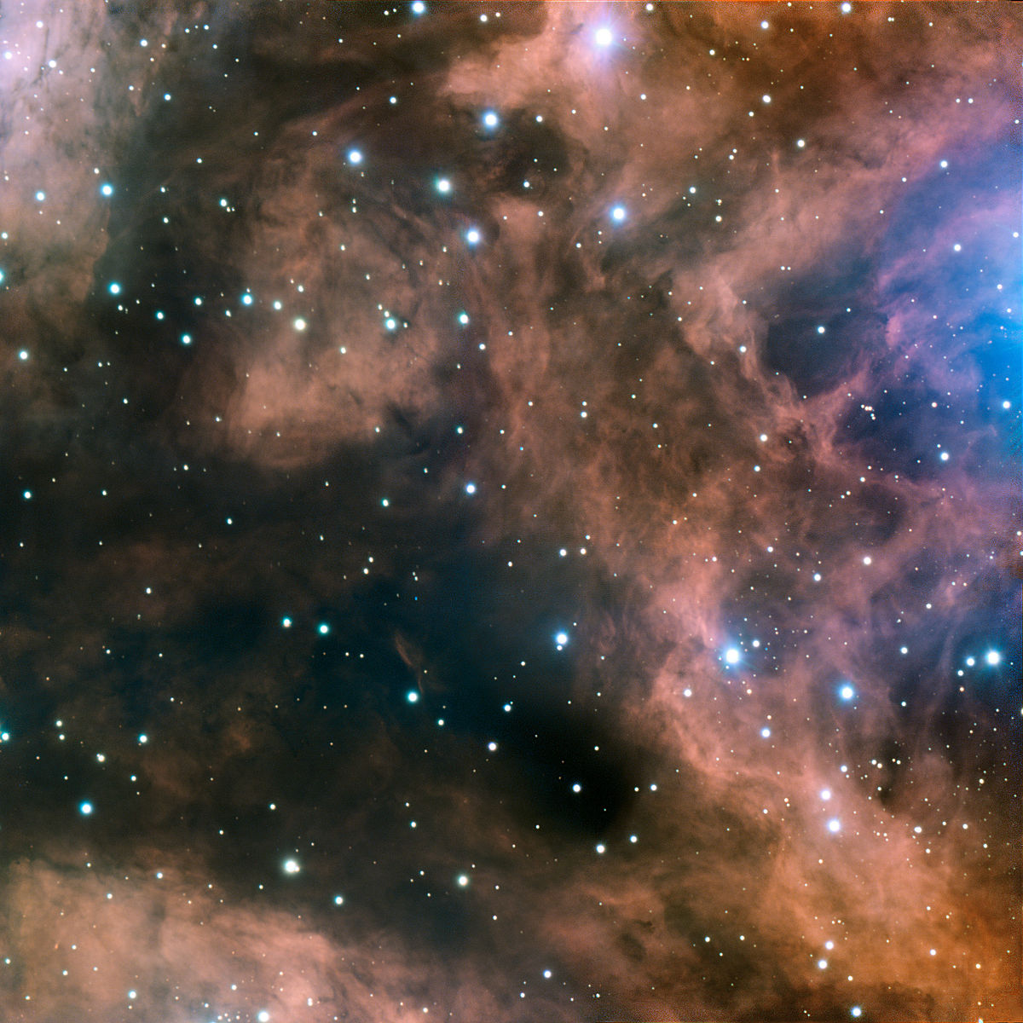
Interstellar medium (ISM)
Interstellar gas (99%)
  Gas clouds
  Nebula
Interstellar dust (~1%)
Cosmic rays – studied by High energy physics

Slide 3
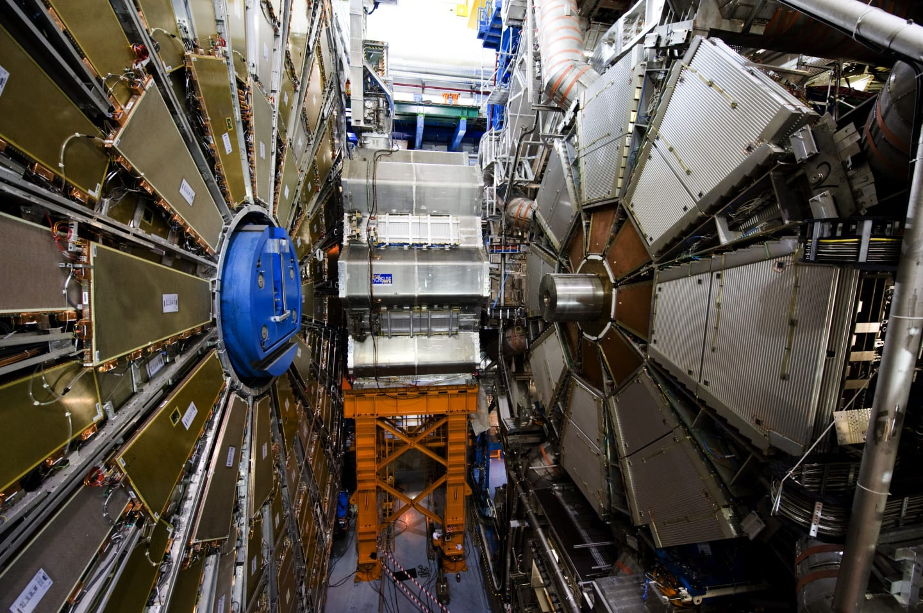
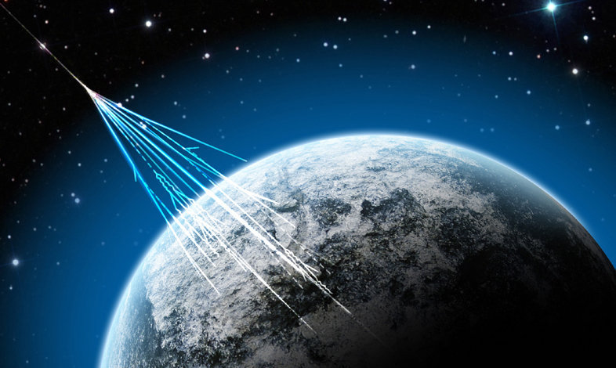
HEP Introduction
HEP – High Energy Physics. All physics at the energies higher than nuclear (10s of MeV, or million electron-volts)
Studies subatomic particles, fields, interactions – fundamental science research
Tools – space, accelerators, detectors
Real-life applications from HEP – microwave, internet browser, ftp/http protocols ☺

Slide 4
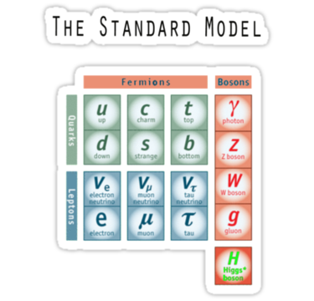
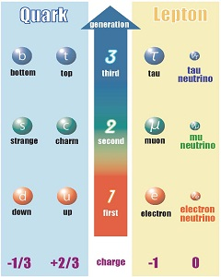
Standard Model
Includes particles
Fermions (spin ½, or n/2)
Hadrons (quarks)
Bosons
Interaction carriers (quanta of the corresponding fields)
Leptons
3 Generations
[j-park.jp]

Slide 5
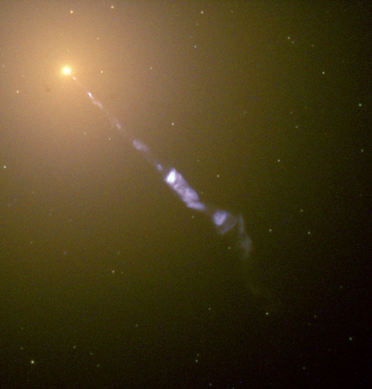
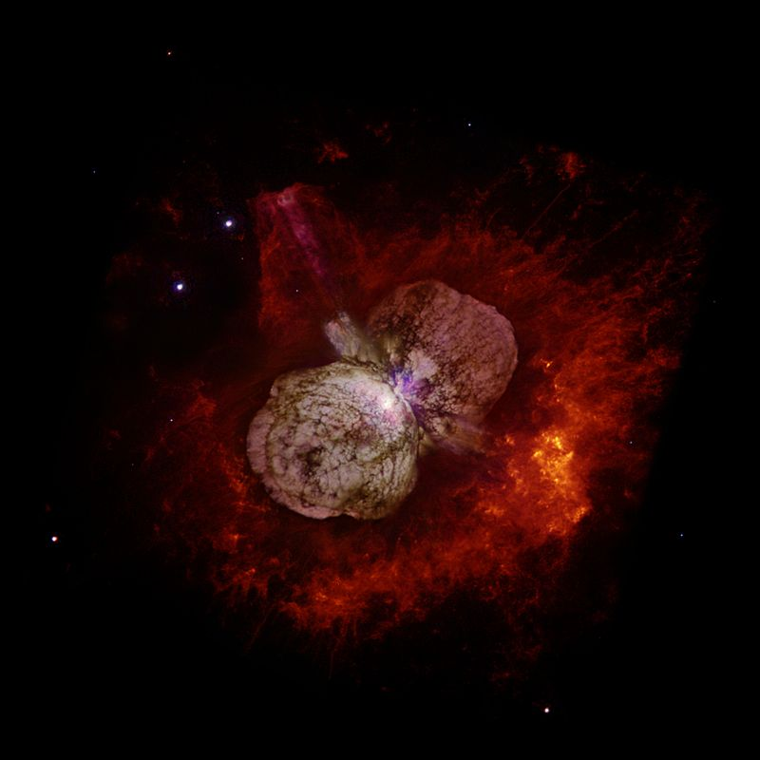
The studies of the Ultra-high energy Cosmic Rays (UHECR) is vital for the solutions of the fundamental problems in astrophysics and the high energy physics in respect to their sources and acceleration mechanists, nature of the dark matter and, possibly, violations in the theory of relativity principles.
en.wikipedia.org/wiki/Active_galactic_nucleus
The large mystery today is the origin and the nature of UCR
Cosmic Rays (possible) Sources:
Neutron Stars
Active Galactic Cores
(converting dark matter
into high energy protons?)
Hypernova Explosions
Decay of unknown massive particles or dark matter
http://en.wikipedia.org/wiki/Hypernova

Slide 6
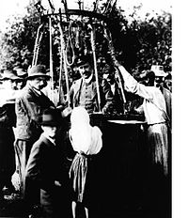
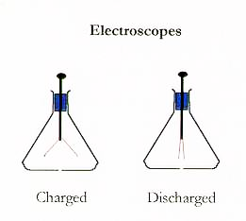
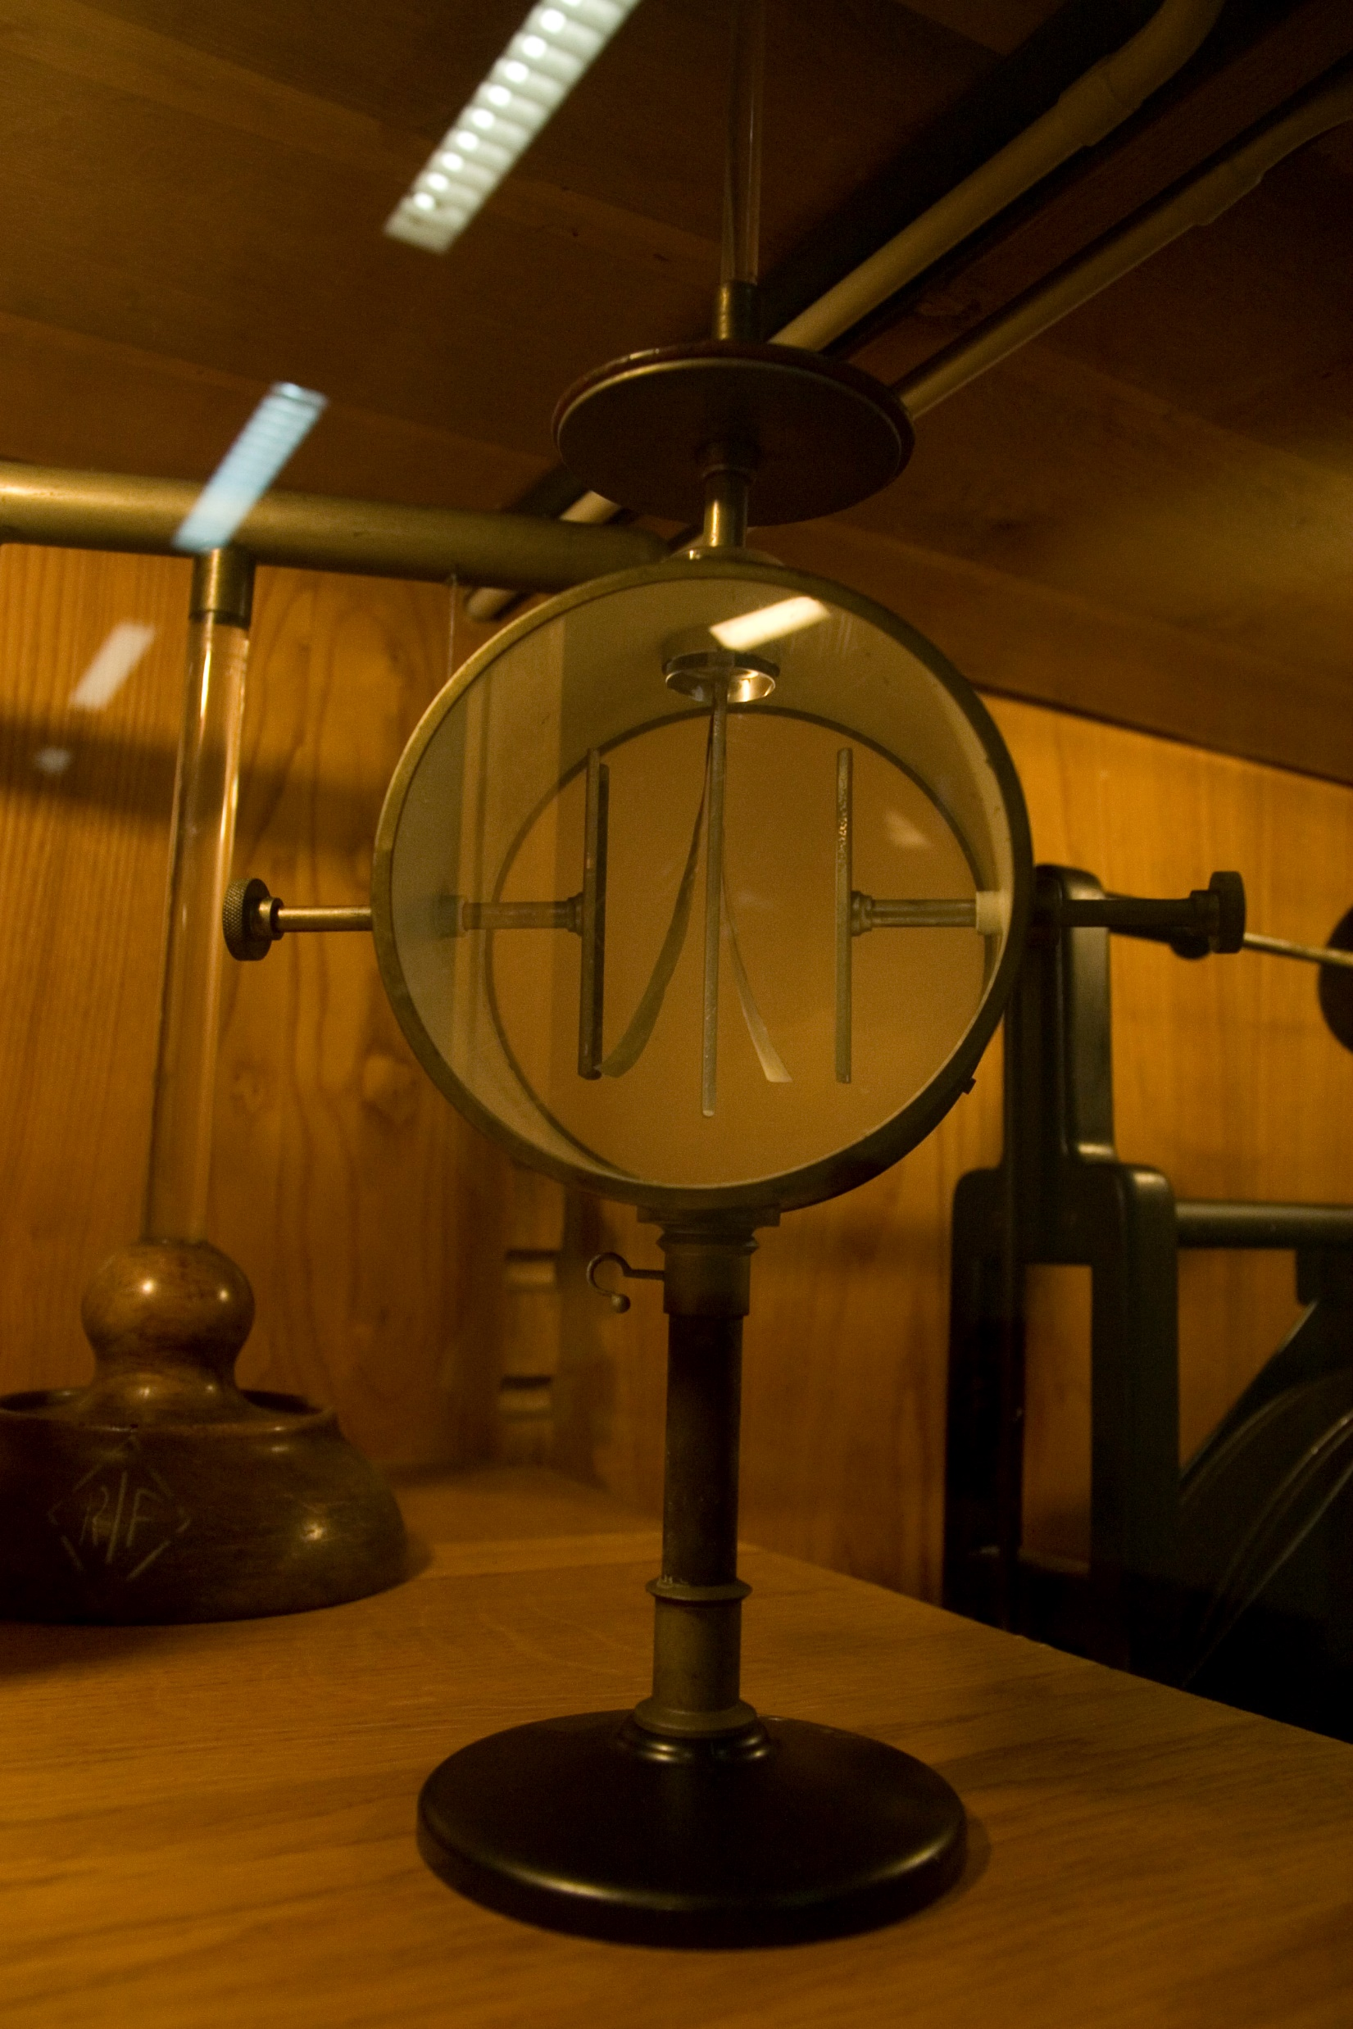
Cosmic Rays discovery
August 7, 1919 – Balloon flight by Victor Hess
in the last of seven flights that year, Hess made an ascent to 5300 meters.
Using electroscope, he found the rate of ionization was >3 times that at sea level
He concluded that penetrating radiation was entering the atmosphere from above.

Slide 7
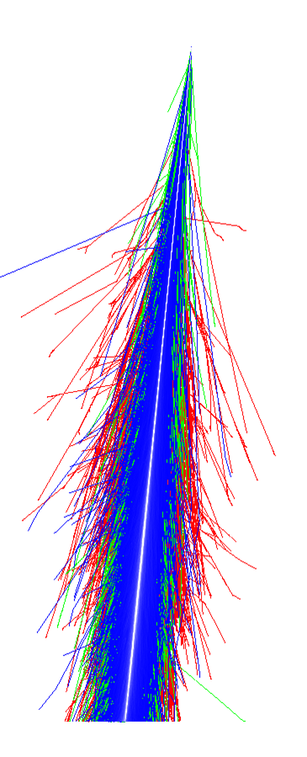
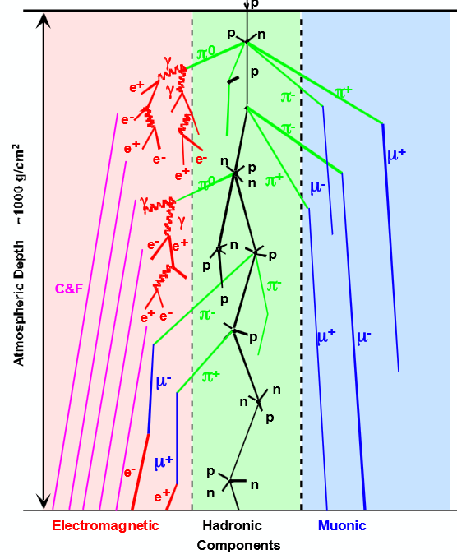

Extensive Air Showers (EAS)
Hadronic
EM
Muon
components

Slide 8
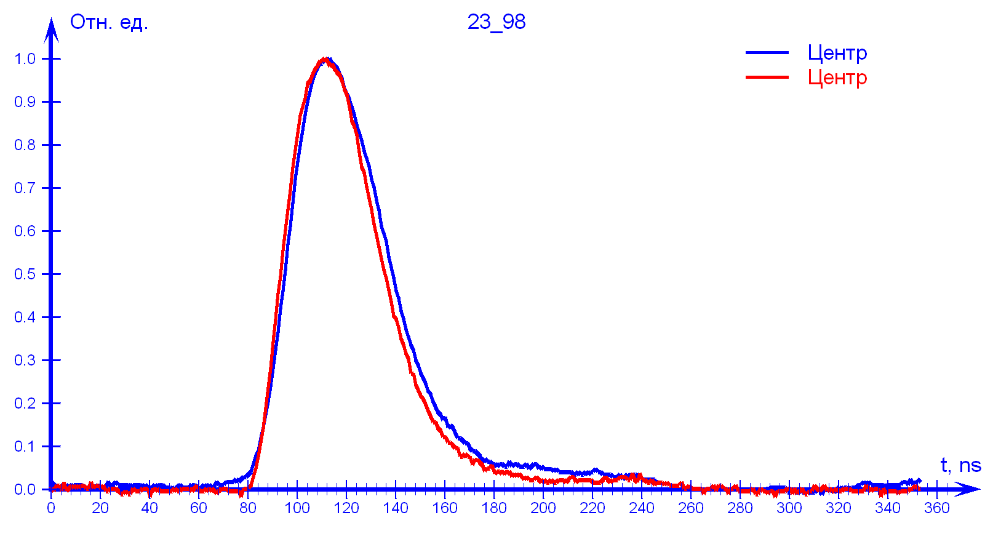
EAS structure
Each component forms a thin disk (about 2-3 meters thick and several km in diameter) moving at ~ speed of light
Can enquire the energy from the size and intensity of each component, and the direction from the delay between disks hitting different parts of the detector.
Typical signal in 2 detectors located at the same station (0m distance)

Slide 9
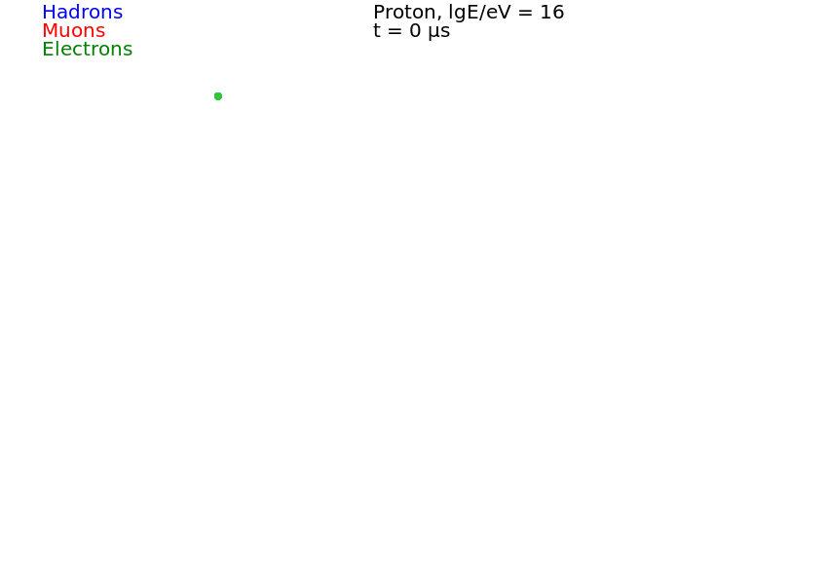
EAS animation, parent – proton at 10¹⁶ eV

Slide 10
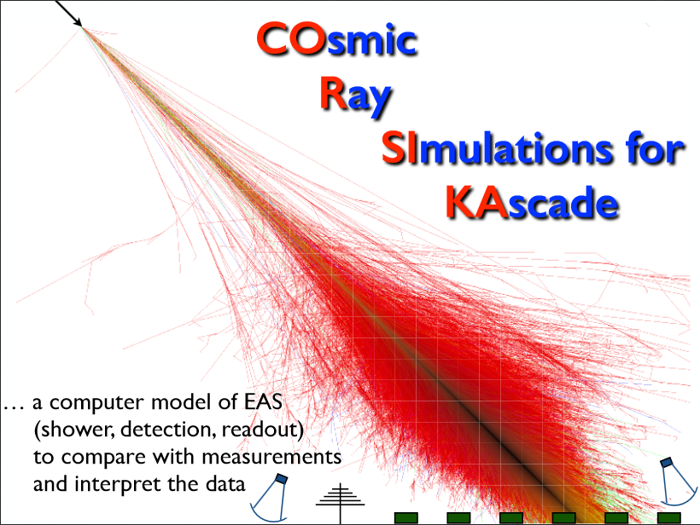
EAS Simulation

Slide 11
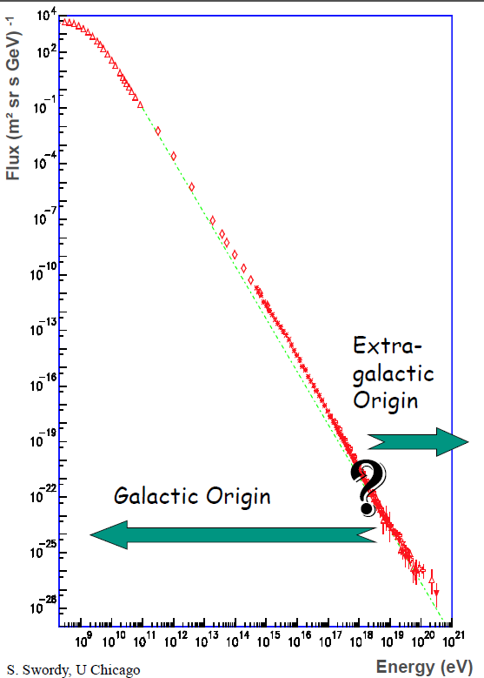
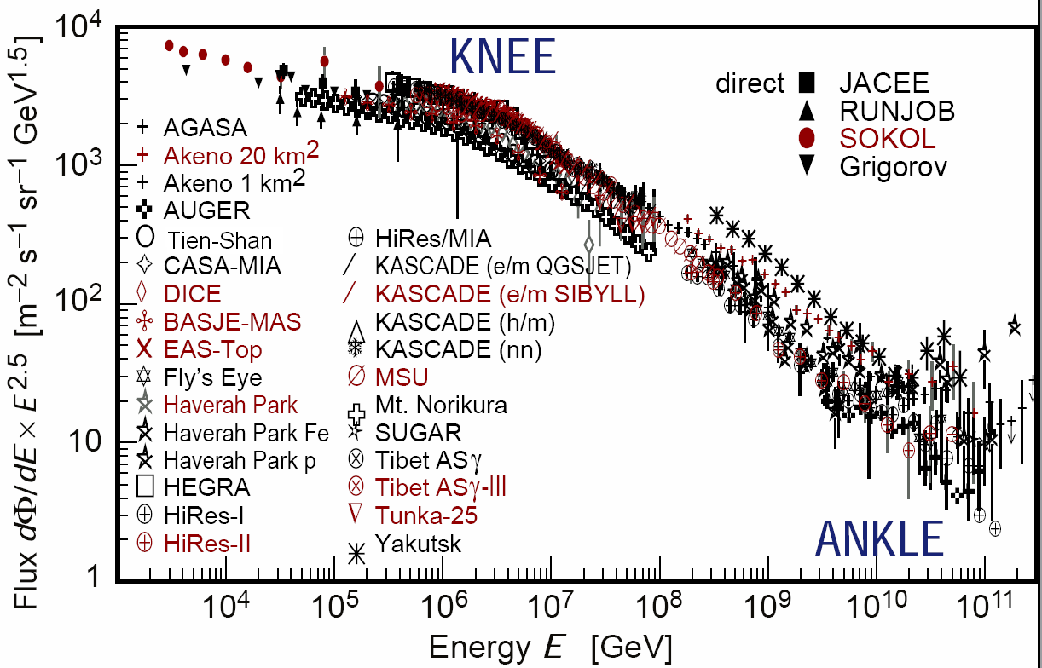
EAS Energy Scale

Slide 12
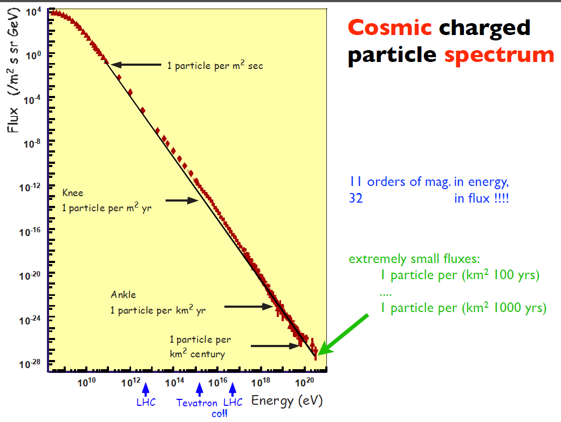

Slide 13
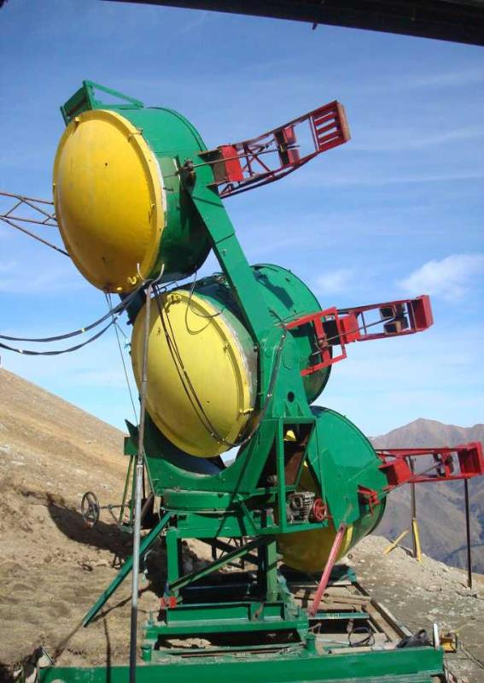
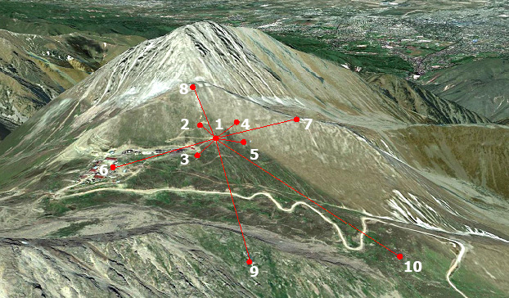
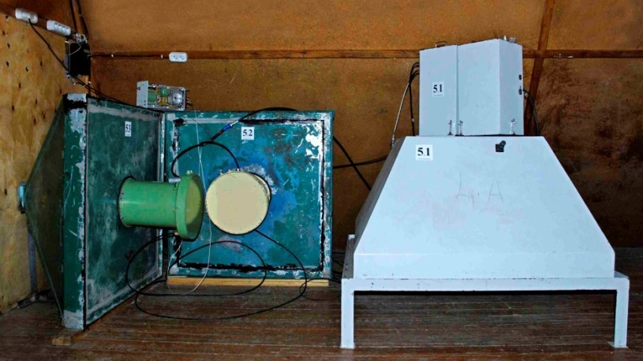
Tyan-Shan cosmic rays observatory
10 scintillator detectors
Up to 1 km separation
Cerenkov light detector

Slide 14
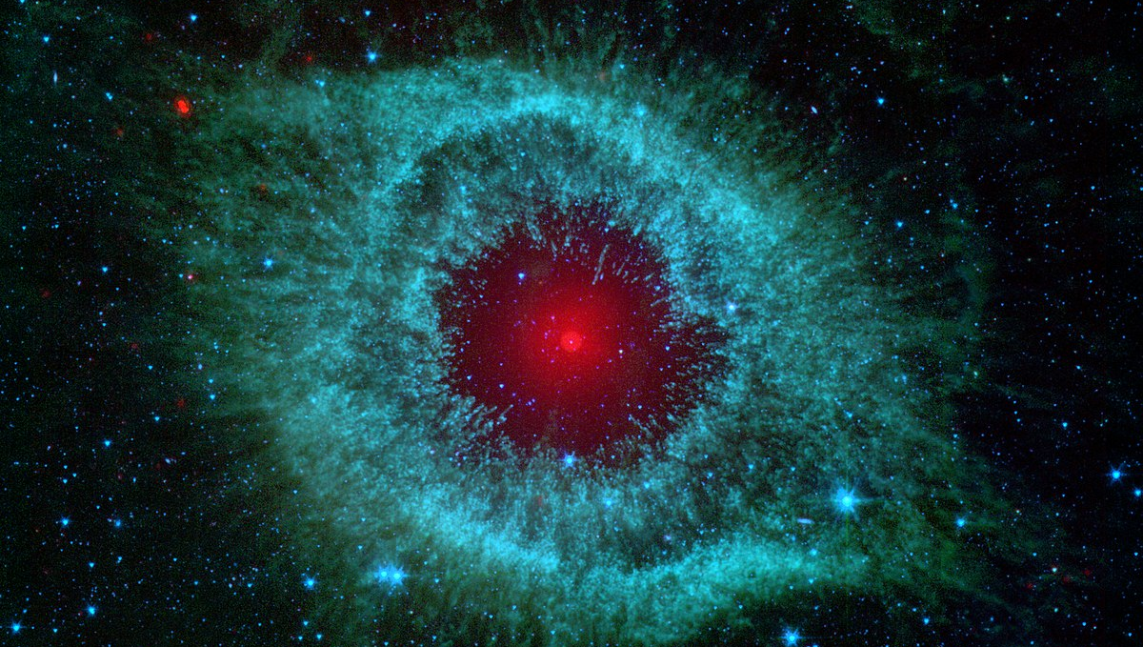
Any Questions?

Slide 15
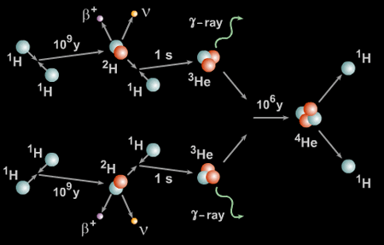


Recall: Star is
http://astronomyonline.org/Stars/Evolution.asp
A formation mostly out of hydrogen
Produces energy via nuclear fusion
P-p cycle, CNO cycle
Can be binary (or more) and/or have planets
Videos from http://www.windows2universe.org/sun/Solar_interior/Nuclear_Reactions/Fusion/Fusion_in_stars/H_fusion.html

Slide 16
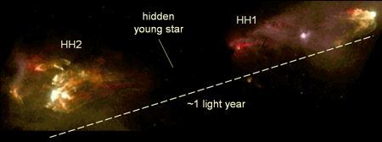
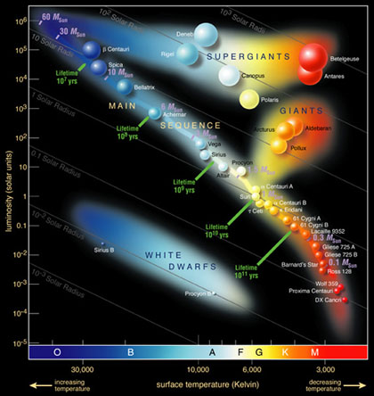
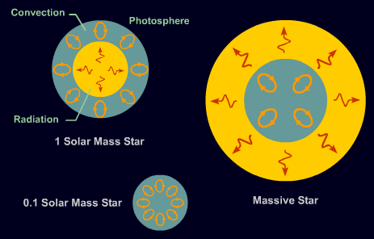
Start are born in the nebulae nurseries
http://astronomyonline.org/Stars/Evolution.asp
http://astronomyonline.org/Stars/Evolution.asp
http://astronomyonline.org/Stars/Evolution.asp

Slide 17
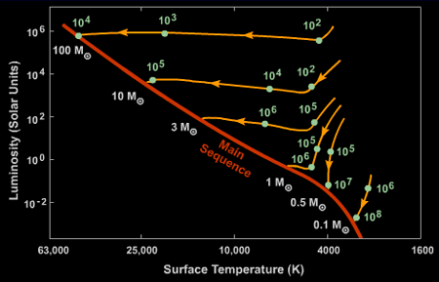
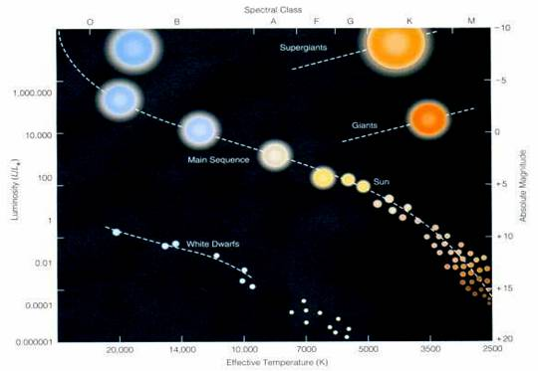
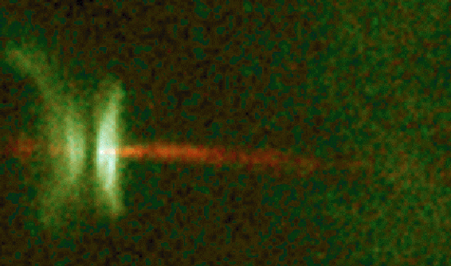
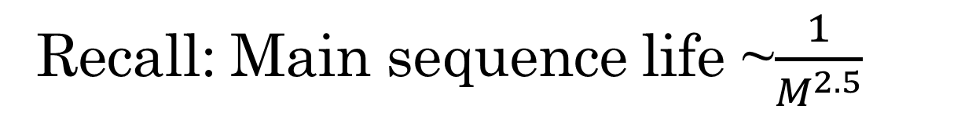
Recall: Main sequence life ~$\frac{1}{M^{2.5}}$
http://astronomyonline.org/Stars/Evolution.asp
http://www.kheper.net/cosmos/stars/stars.htm

Slide 18
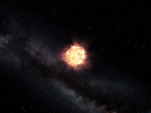
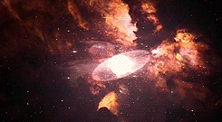
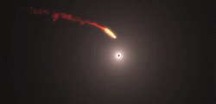
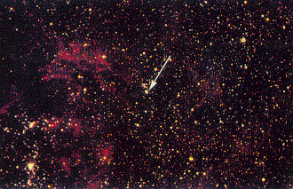
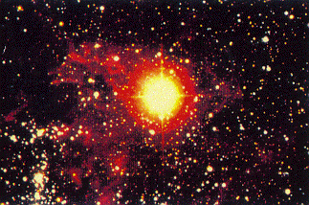
Spectacular death of massive stars
http://rebloggy.com/post/gif-1k-space-stars-explosion-supernova-the-universe-hypernova-how-the-universe-w/17058837395
http://umich.edu/~gs265/star.htm
http://umich.edu/~gs265/star.htm
A section of space before the supernova
A same section after the supernova

